Slide 1
Using Switches to Program A candy Sorter
Designed for use with LMS EV3 programming and building environment

Slide 2

Evaluating Candy Sorters
Watch
Discuss
How does this sort the candy?
What is one part you really like about it?
What is one weak point in the build?
What is one thing you would change to improve the machine?

Slide 3
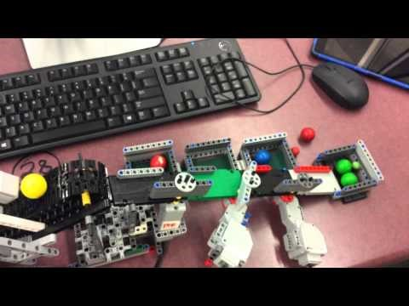
Evaluating Candy Sorters
Watch
Discuss
How does this sort the candy?
What is one part you really like about it?
What is one weak point in the build?
What is one thing you would change to improve the machine?

Slide 4

Evaluating Candy Sorters
Watch
Discuss
How does this sort the candy?
What is one part you really like about it?
What is one weak point in the build?
What is one thing you would change to improve the machine?

Slide 5
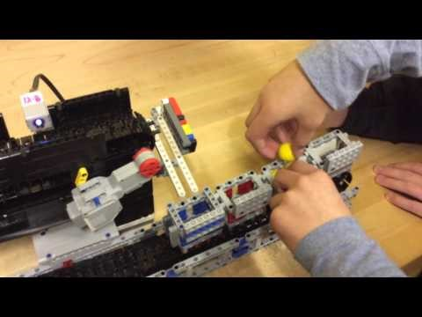
Evaluating Candy Sorters
Watch
Discuss
How does this sort the candy?
What is one part you really like about it?
What is one weak point in the build?
What is one thing you would change to improve the machine?

Slide 6


Different STyle
These two groups used the reflective property of the gumballs to sort them into “cool” and “warm” colors. What are the advantages and disadvantages of doing it this way?
Watch
Watch

Slide 7
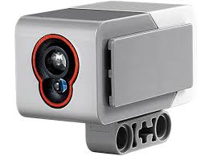


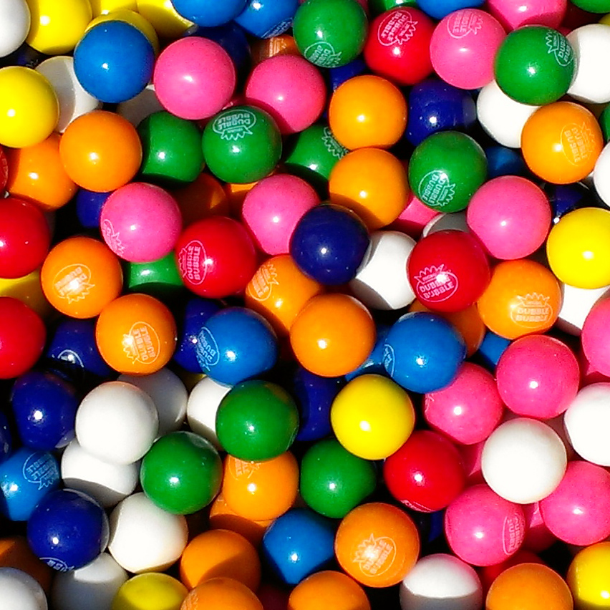
EV3 Color Sensor
3 Modes
Ambient
Reflective
Color
It can detect the overall amount of light in a room
One bulb “shoots” a beam of light at a surface, the other bulb “reads” the percentage of light reflected back
The color sensor can detect black, white, red, blue, green, yellow, and “no color”

Slide 8
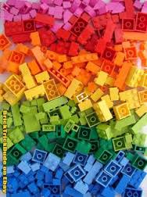
In color mode it works best with LEGO

Slide 9

For Example these dark blue gumballs might be read as black
Don’t try to force the software to read the “correct” color
Instead, accurately record the color it says an object is and use that throughout your program

Slide 10
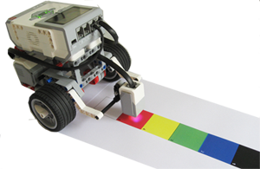
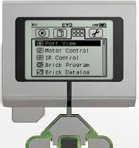
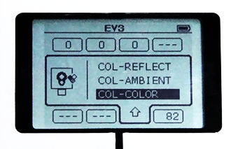
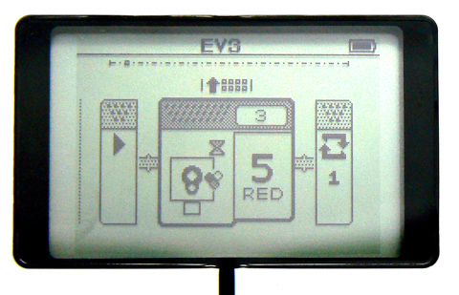
Using the color sensor
Hold it close to color (about half inch)
On the brick, navigate to port view, choose the sensor, then make sure you choose the right mode

Slide 11
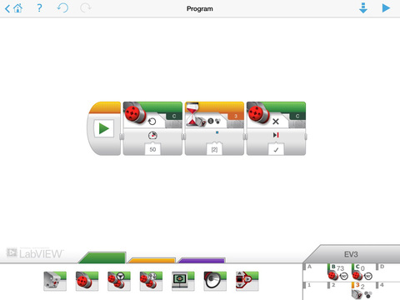
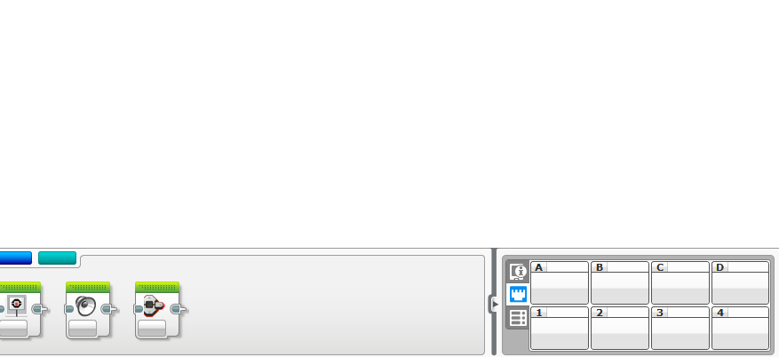
Using the color sensor
Hold it close to color (about half inch)
Using the EV3 software or iPad App you click on the bottom right to get to port view

Slide 12
Using your color sensor what readings do you get for your gumball/candy?
Actual Color | Reflective Light Mode | Color Mode

Slide 13
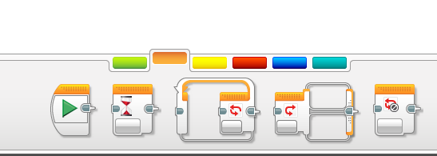
A switch is found in the orange flow palette

Slide 14
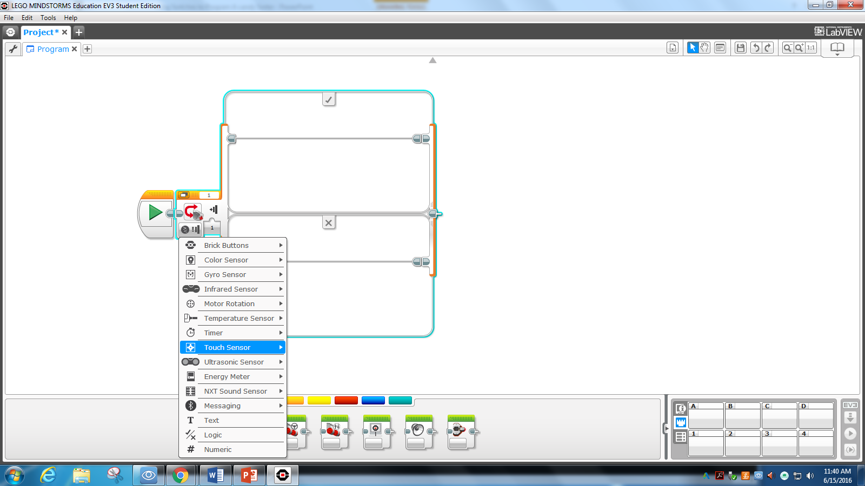
A Switch checks a condition, then chooses a path based on that condition
Choose what type of switch you want
This is a touch sensor switch
It will “choose” what action to take based on the condition of the touch sensor in port 1

Slide 15
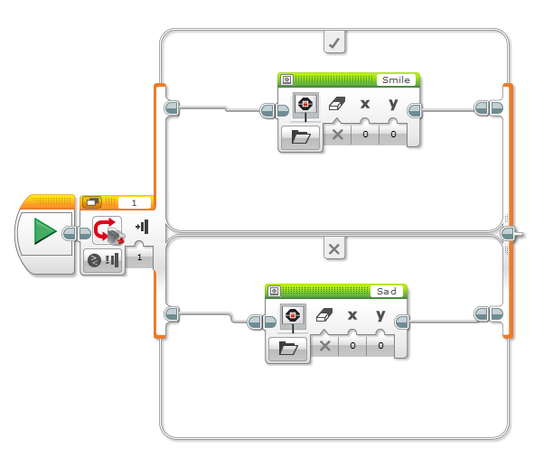
Two choices – Compare mode
Touch sensor is set to “push in”
That’s the “true” statement
Think “true” = “top”
It will do what’s on top (in this case show the smile image) if the statement is true
If touch sensor is not pushed in (false) the bottom action is chosen (display sad image)

Slide 16
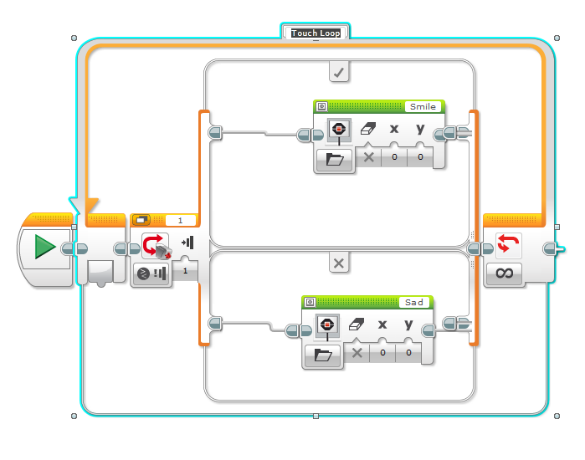
By placing switch in a loop, you can continuously change the displayed image
When touch sensor is pushed in, it will show the smile image
When touch sensor is out, it will show the sad image

Slide 17
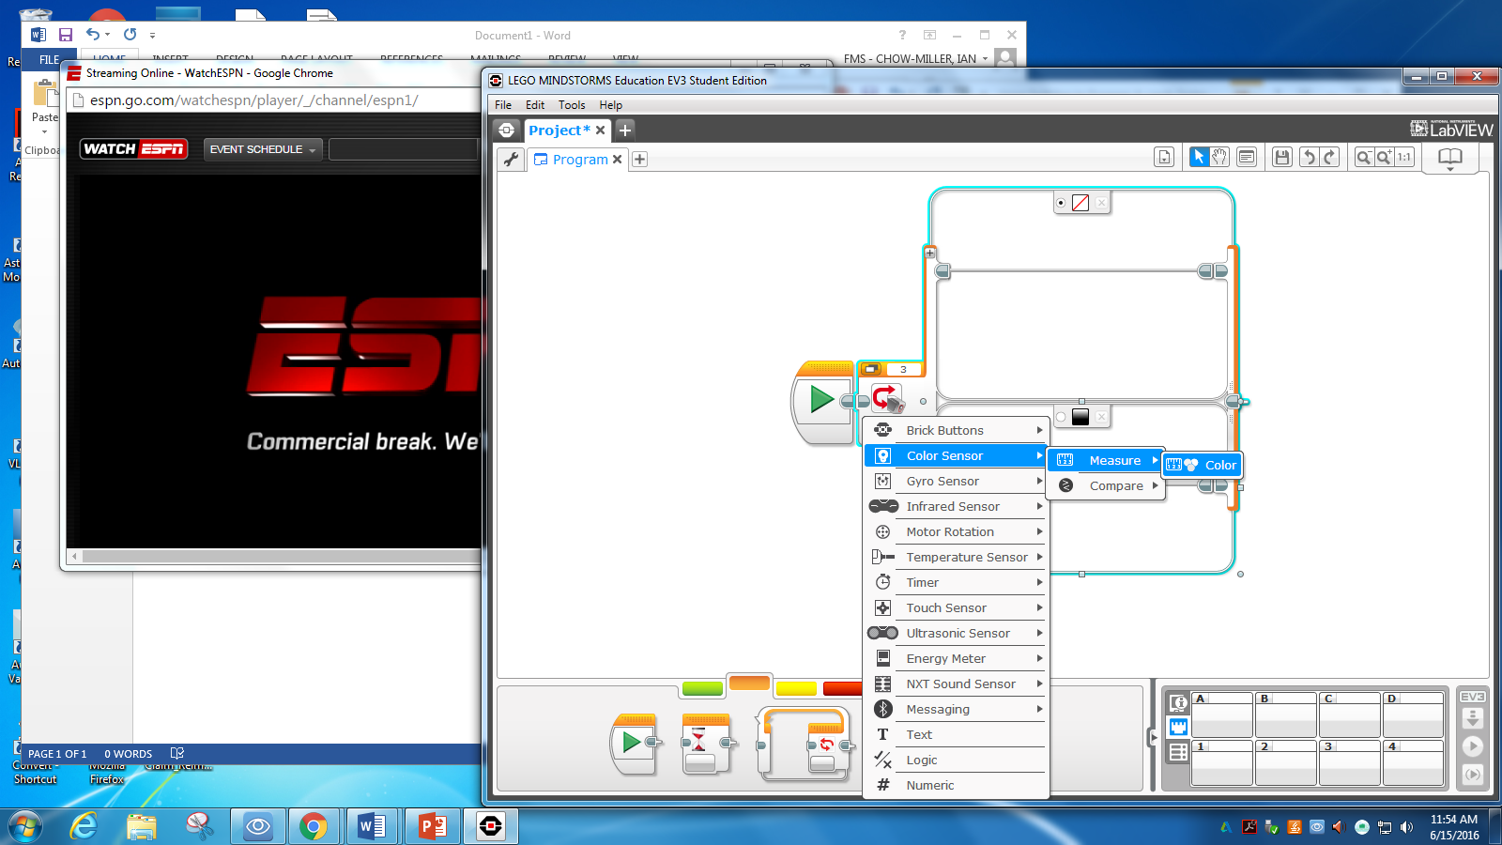
How to Program a color sensor switch
Choose the correct mode
Choose color Sensor
Then choose measure
Then choose color

Slide 18
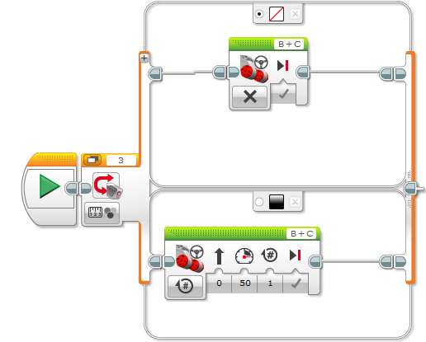
Color Sensor Switch
You can choose a default (What the program should always do if nothing is happening)
Click this circle to assign a case to be the default
In this example if no color is sensed, the motors will stop
If black is sensed the motors will turn on for 1 rotation at half power (50)
But if another color is sensed, the motors will also stop, because that is the default position and we haven’t added other colors yet

Slide 19
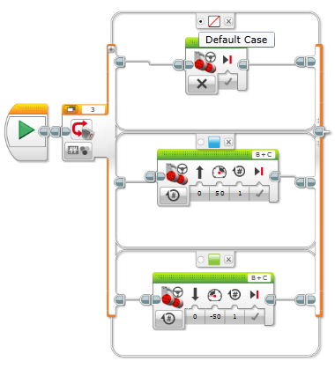
Adding more colors/conditions
If you wish to add more conditions, click the plus sign
You can add as many as you like (but you only have a few different colors, so you are limited)
In this example I have kept motors stop as my default action (and also the no color action)
If blue is sensed, my motors turn forward for one rotation
If green is sensed, my motors turn backwards for one rotation

Slide 20
Now it’s your turn – helpful hints
Programming
building
Color sensor
A switch with several colors won’t be enough.
The switch will have to be a part of a larger more complex program
Work on one part of the program at a time
Test one color at a time rather than trying to write the program for all colors
Solid building is important – if parts move weakly, or are not supported, or are not solid, it won’t work
Use cross bracing to support your structure
Connect motors so they spin axles rather than motors spinning around axles
Must be close (1/4 inch is good) to object it will detect
Must be static, a color sensor that moves or swivels will not work
Constantly check and recheck your readings

